Slide 1
NSE INDICES
18 August 2025

Slide 2

NSE Indices Limited (Formerly known as India Index Services & Products Limited-IISL)
Q. How many companies are listed on India's two most prominent stock exchanges?
A. As of 2025: National Stock Exchange (NSE) has 2,629 listed companies, and the Bombay Stock Exchange (BSE) has 5,595 listed companies. The total across both of them is over 7,500.

Slide 3
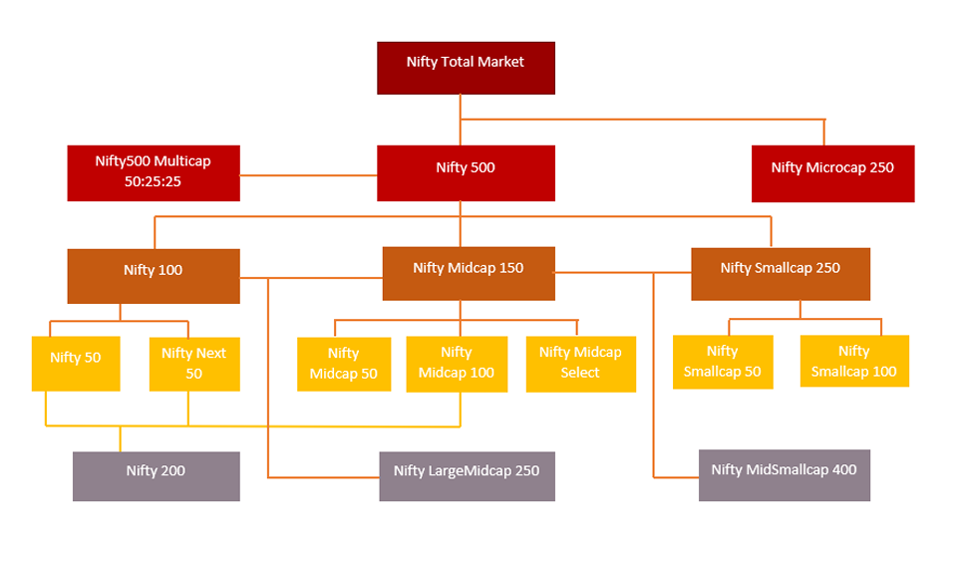
In order to develop, construct and maintain indices on Indian equities that serve as useful market performance benchmarks that may be useful underlying indices for investment products, NSE Indices Limited, an NSE group company has developed a series of broad equity indices introducing a structure that efficiently represents large, mid and small market capitalization segments of the Indian capital market.

Slide 4
Indices:
Nifty 500 – Top 500 companies by full market capitalization from the eligible universe.
Nifty 100 – Top 100 companies by full market capitalization from Nifty 500 (large-cap performance).
Nifty Midcap 150 – Companies ranked 101–250 by full market capitalization from Nifty 500 (mid-cap performance).
Nifty Smallcap 250 – Companies ranked 251–500 by full market capitalization from Nifty 500 (small-cap performance).
Nifty 50 – 50 companies from Nifty 100, selected based on free-float market cap, liquidity (impact cost ≤ 0.5%), and availability of derivative contracts.

Slide 5
Nifty Next 50 – Remaining 50 companies from Nifty 100 after excluding Nifty 50. Non-F&O stocks capped at 10% cumulatively and 4.5% individually (quarterly rebalancing).
Nifty Midcap 50 – Top 50 companies from Nifty Midcap 150 based on free-float market cap, turnover, and F&O availability.
Nifty Midcap 100 – All companies from Nifty Midcap 50 plus remaining selected from Nifty Midcap 150 based on turnover.
Nifty Midcap Select – 25-stock focused portfolio from Nifty Midcap 150 based on market cap, turnover, and F&O availability.
Nifty Smallcap 50 – Top 50 companies from Nifty Smallcap 250 based on free-float market cap, turnover, and liquidity.
Nifty Smallcap 100 – All companies from Nifty Smallcap 50 plus remaining selected from Nifty Smallcap 250 based on turnover.

Slide 6
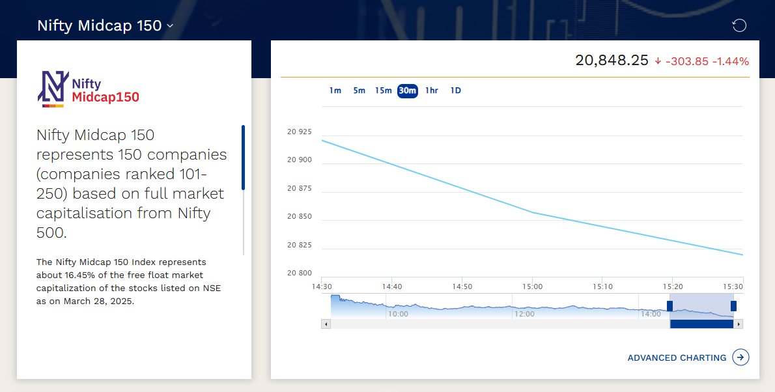
How to access Index Data
For example: NIFTY Midcap 150

Slide 7
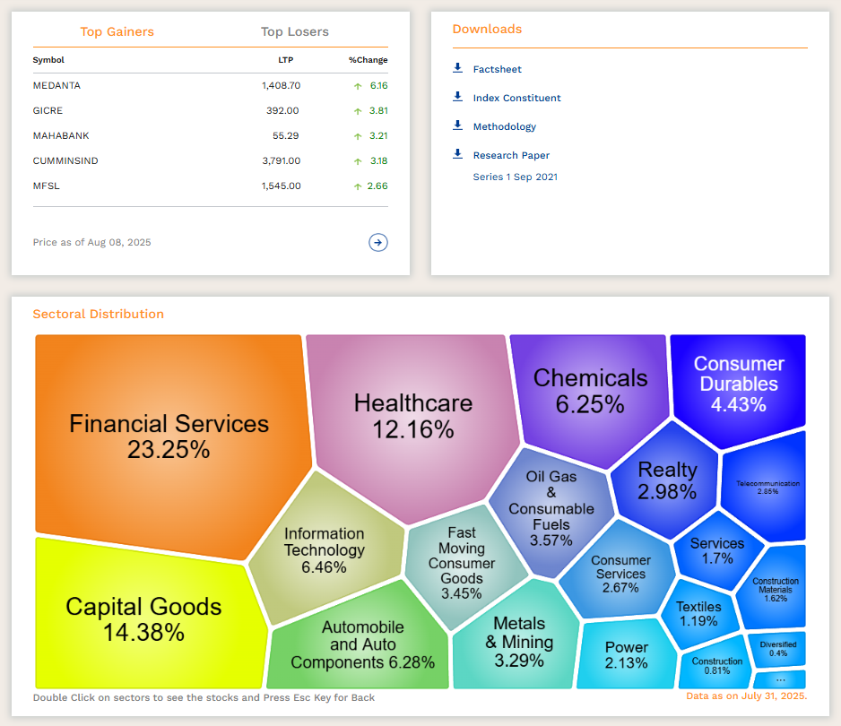

Slide 8
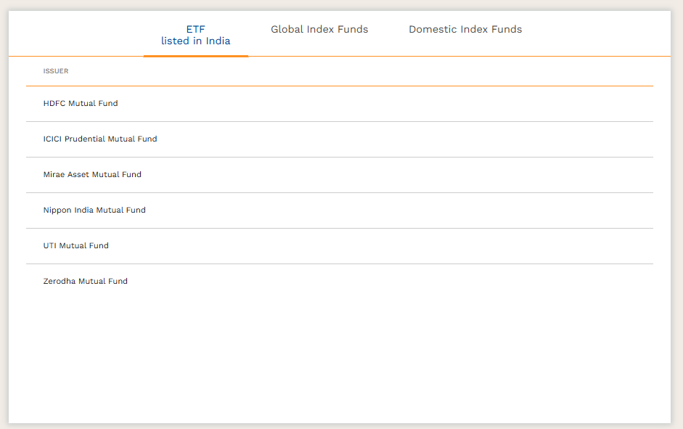

Slide 9
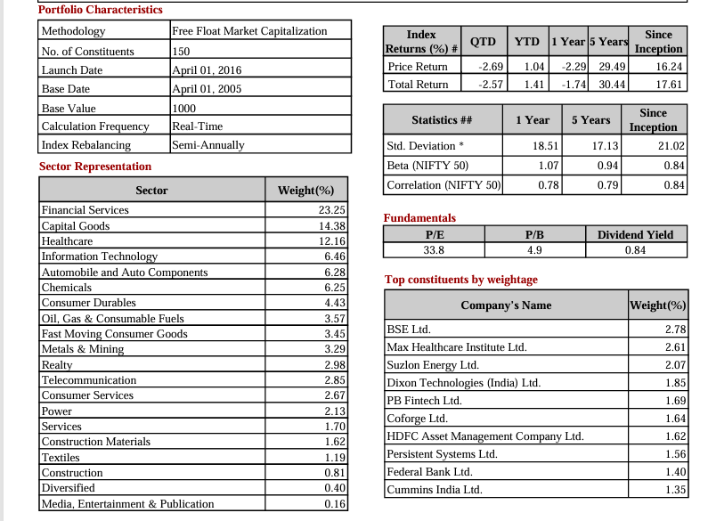

Slide 10
Inclusion in Nifty 500 index
Company must be domiciled in India and listed & traded on NSE.
Convertible stock, bonds, warrants, rights, preferred stock with fixed return, suspended stocks, and BZ series stocks are not eligible.
Equity with Differential Voting Rights (DVR) eligible if DVR criteria are met.
Free float requirement: IWF ≥ 0.10 (10% free float) OR 6-month avg. free-float market cap ≥ 25% of smallest Nifty 500 constituent’s full market cap.
Must be traded on ≥ 90% of days in the past 6 months.
Average impact cost ≤ 1% in the past 6 months.
For newly listed securities, criteria checked on 1-month data instead of 6 months.
Must rank within top 800 by both avg. daily turnover and avg. daily full market cap (6-month data).

Slide 11
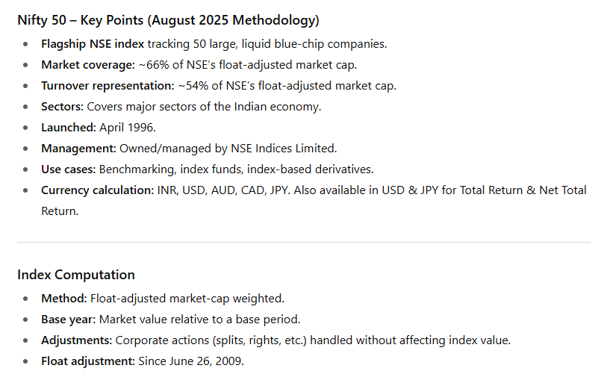
NIFTY 50: The Flagship Index

Slide 12
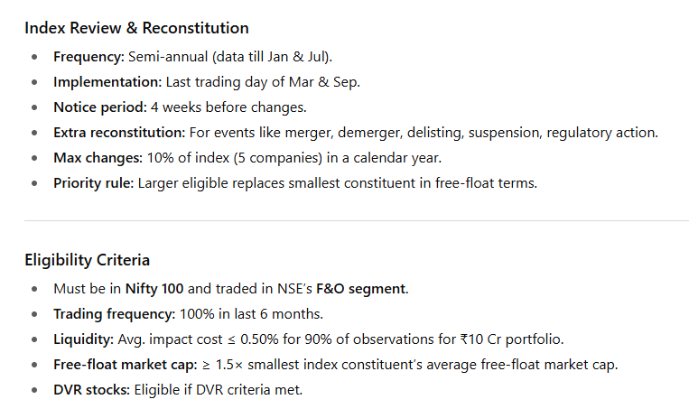
NIFTY 50: The Flagship Index

Slide 13
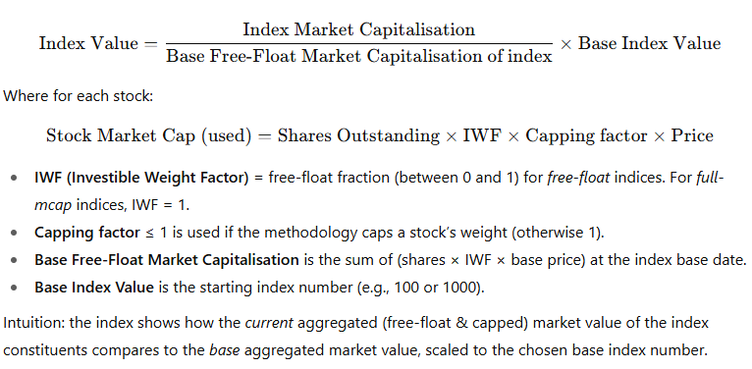
Index Calculation Formula

Slide 14
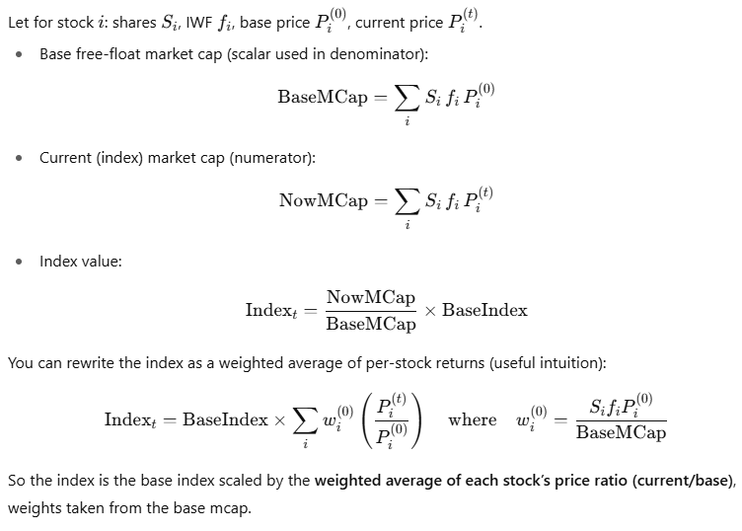

Slide 15
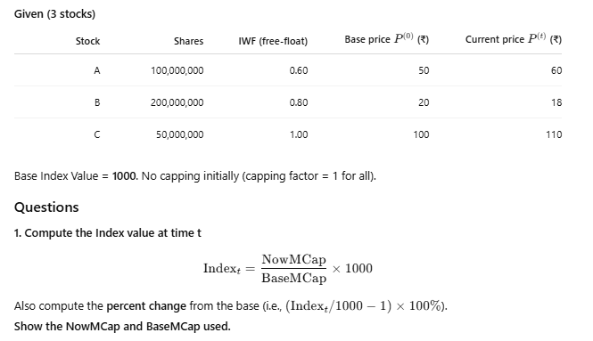

Slide 16
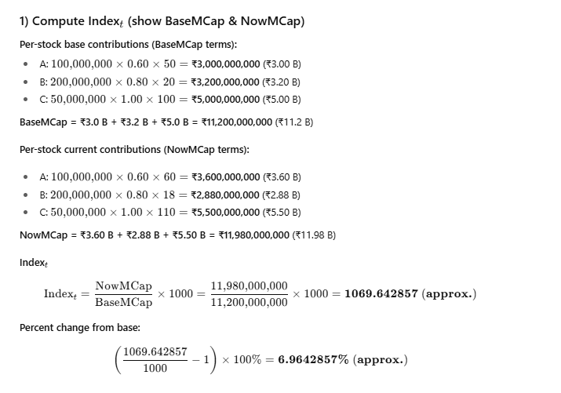

Slide 17
Further Readings
NIFTY Indices
Methodology Document for Equity Indices
Nifty 50 Whitepaper 2024_V3

